Slide 1
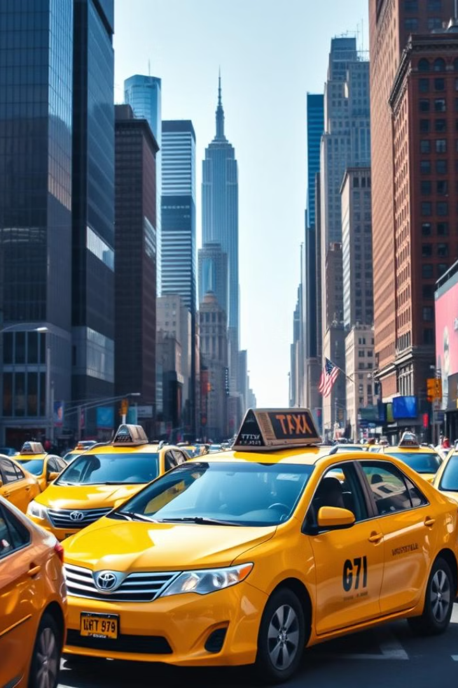


Analysis of Ride Patterns and Fare Dynamics in New York City TLC Trips
Unlocking potential of iconic NYC transportation.
Neha Shastri (Project Manager)
Glenn Castellino
Hyunjin Yu
Raskirt Bhatia
Quan Nguyen
Yifeng Chen
by Glenn Castellino

Slide 2







Project Proposal & Motivation
Trip parameters
Time-series Analysis
Customer Behaviour
Independent Factors
Adverse Weather
Rainfall
Holidays & Events

Slide 3


Data Source

Slide 4
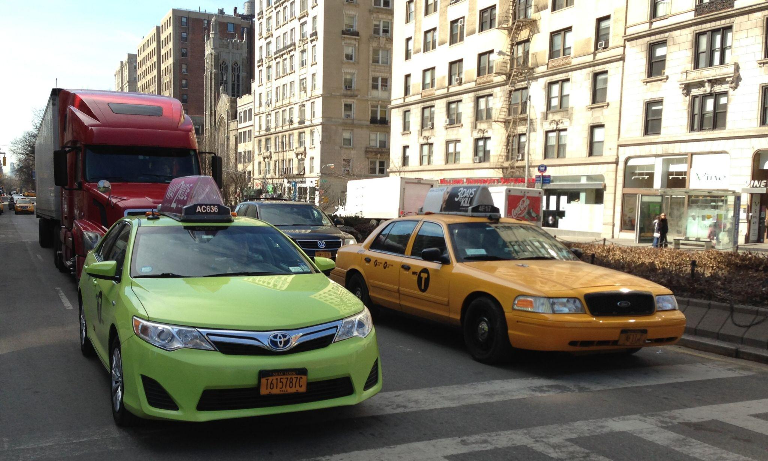
Yellow & Green

Slide 5
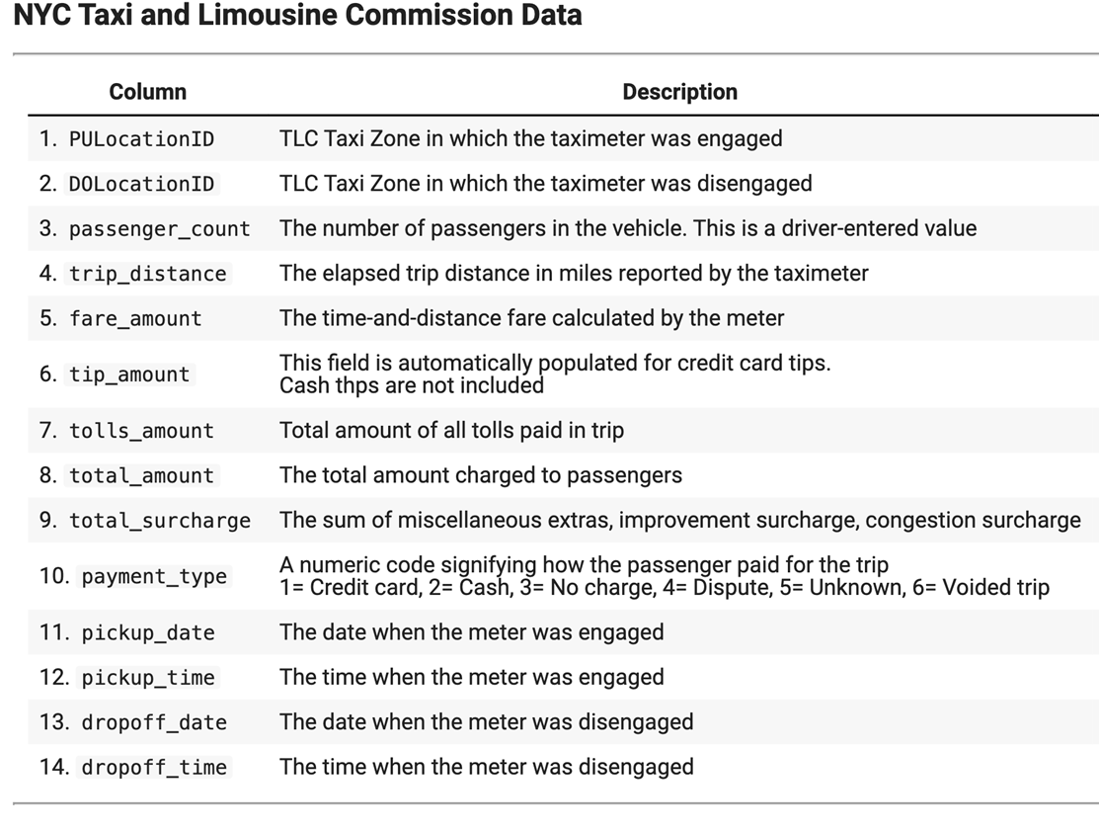
Data Cleaning

Slide 6
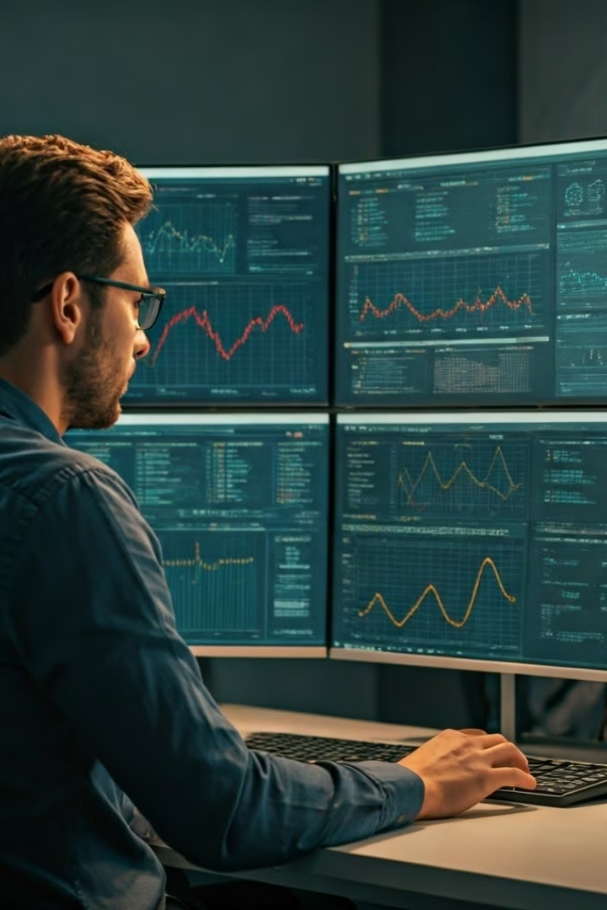



Types of Analysis
Customer Pattern Analysis
Uncover rider behaviors and preferences.
Resource Allocation Analysis
Optimize fleet deployment and efficiency.
Revenue Generation Analysis
Identify opportunities to maximize earnings.

Slide 7
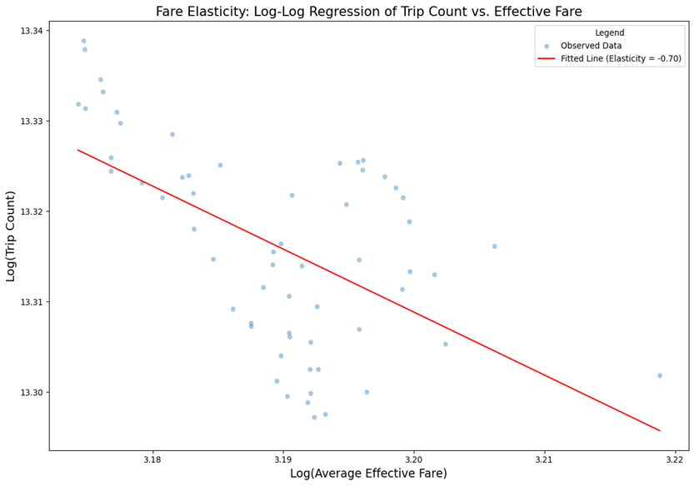
Fare and Trip Pattern Analysis
Fare Increase
Trip Demand Change
1%
-0.7%
Moderate customer price sensitivity observed.
Balance revenue growth with ridership retention.

Slide 8
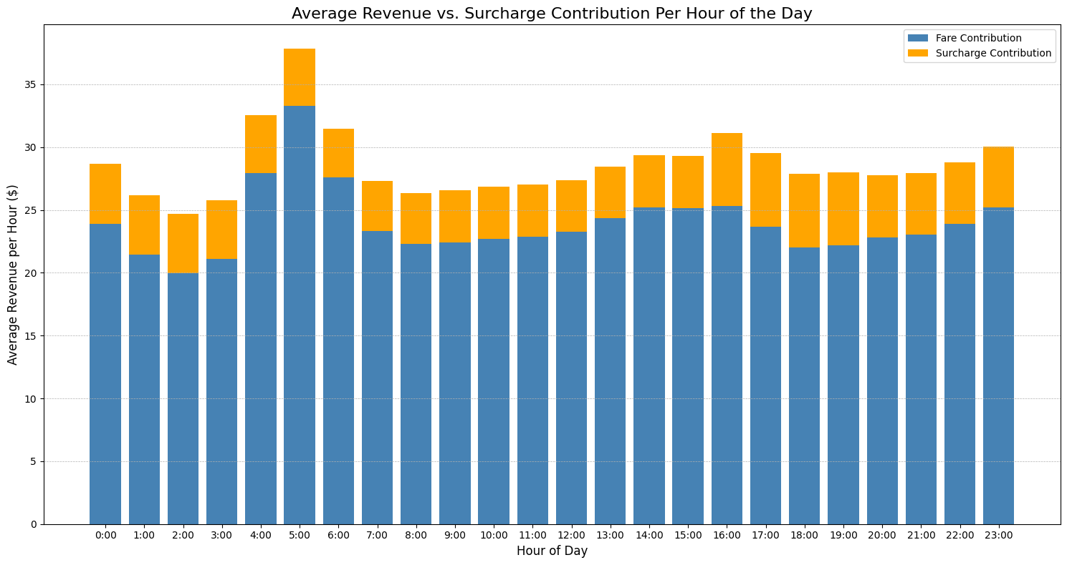



Revenue and Surcharge Analysis
Early Morning Peak
Evening Surcharge Spike
Strategic Pricing
Highest revenue 4-6 AM with significant surcharges.
Highest surcharges 4-7 PM despite revenue decline.
Optimize fare structure based on demand patterns.

Slide 9
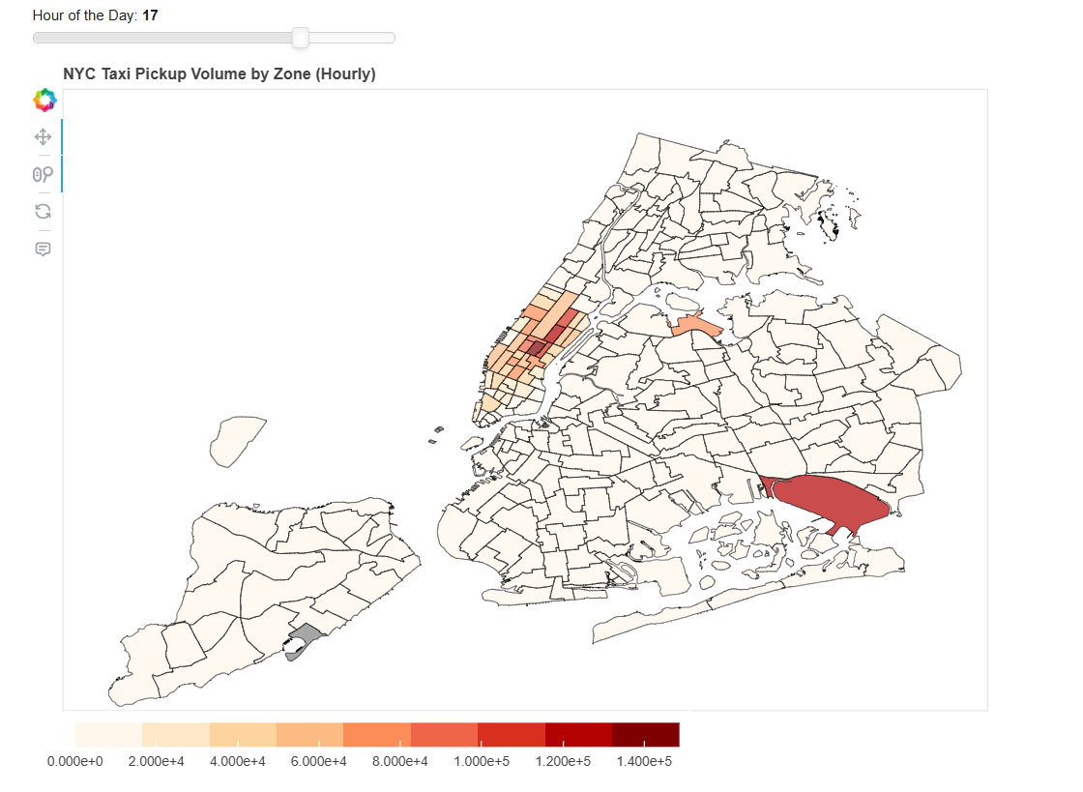
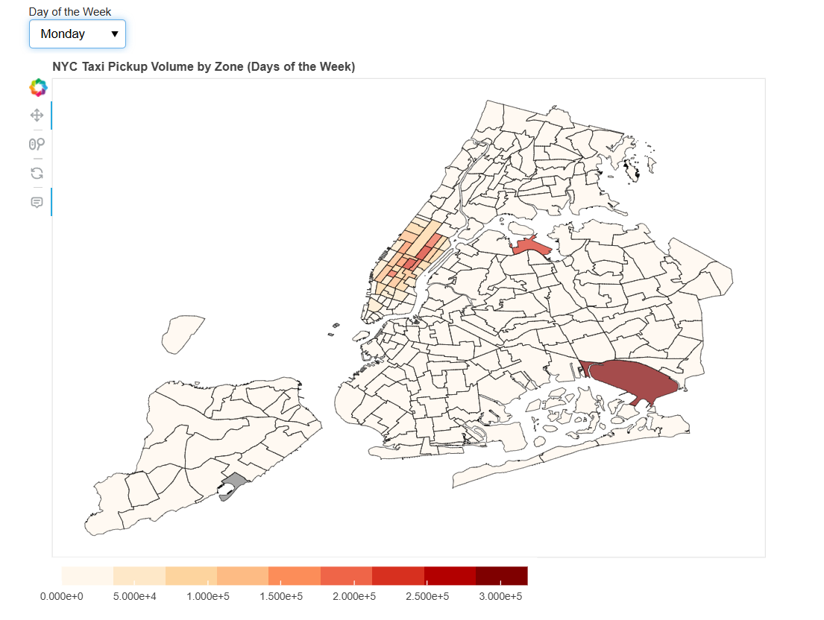
Resource Allocation Analysis
Pickup Locations
Visualize high-demand areas for strategic deployment.
Bokeh visualizations
Notes:
Add questions to audience? What time do you guys usually wake up? What day of the week do you want me to pick?

Slide 10
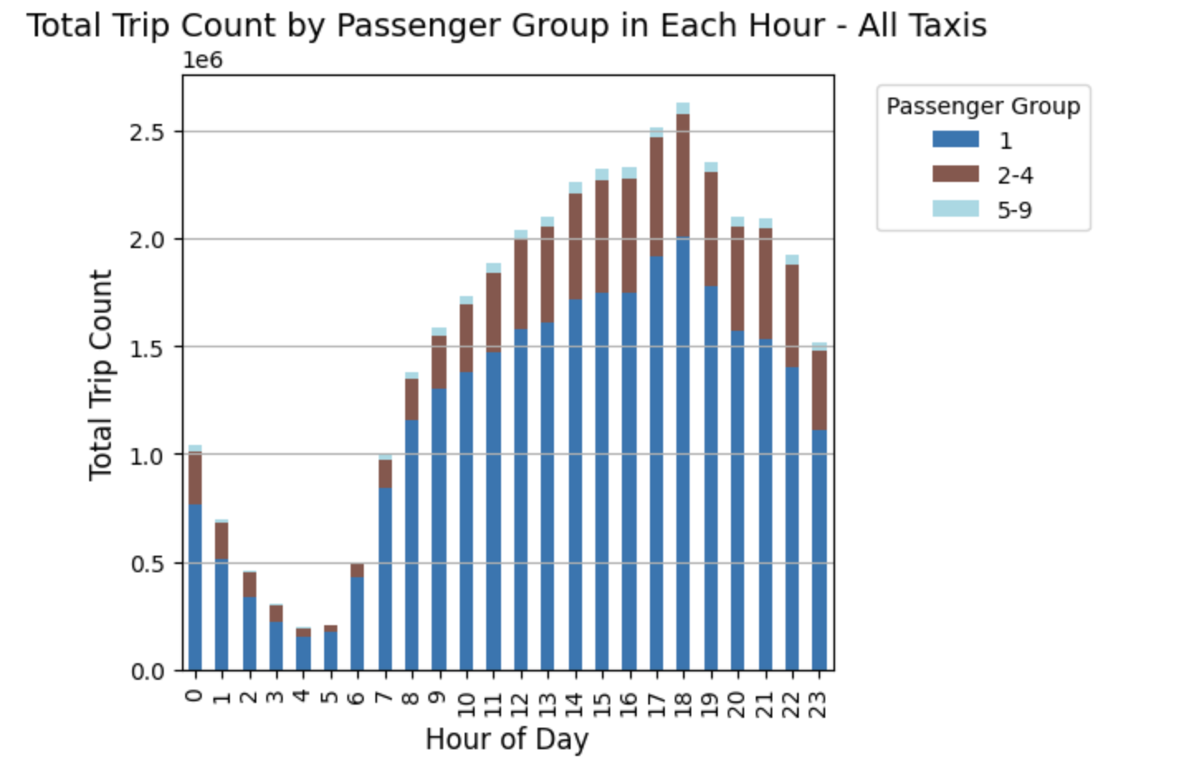
Customer Pattern Analysis
Single-Passenger Dominance
80% single-passenger trips indicate inefficient seat utilization.
Peak Demand Window
Highest demand between 2-6 PM.
Shared Ride Potential
Opportunity to optimize fleet during peak hours.

Slide 11




Recommendations for the Future
Targeted Fleet Allocation
Cashless Transactions
Adaptive Pricing Strategies
Utilize trip volume trends based on weekends v/s weekdays, weather, holidays, etc
Encourage the use of digital payment options to unlock new revenue streams and enhance the passenger experience.
Implement dynamic pricing models to balance revenue growth and ridership retention, responding to changing market conditions.

Slide 12
Thank You!
Q & A

